Slide 1
Screening Scrapper V1

Slide 2
Scope
We need to build a tool which gets the input (product name) from the user and searches the 3 websites and produces the output to the user.
For the user interaction, there should be a page / screen where they can enter the product name and click the search button. On the same page, they should see the results.
The user should have an option to mark the correct results or enter the correct item in case the tool didn’t produce the desired output.
All the above will be saved in the DB for the tool to learn to search (AI).
Product structure
Logic: - The structure of the product is <API> <Strength> <Dosage form>.
Example:-
API – Lorazepam
Strength – 1mg/5ml
Dosage form – Suspension
Though its best case that all the 3 components matches, however, its enough to match the API and the strength.
There are cases in one particular website that the API doesn’t match, in this case, we need to click on the “show” to expand the section to pick (details can be found in the upcoming slides).
There is a variation in strength as well. Like instead of 50mg/5ml it will say 10mg/1ml. (50/5 == 10/1). Or it says 50 mg per 5 ml (more examples can be found in the upcoming slides)

Slide 3
Mockup Screen

Slide 4
RESULTS
1
Search
SEARCH RESULTS
https://products.mhra.gov.uk/ | https://bnf.nice.org.uk/search/ | https://www.medicines.org.uk/emc
Search
Search
Search
2
2
2
Enter the correct product
Enter the correct product
Enter the correct product
3
3
3
Save & Next

Slide 5
USER Screen
Ability for the user to search for the product in 3 websites.
Wesbites
https://products.mhra.gov.uk/
https://bnf.nice.org.uk/
https://www.medicines.org.uk/emc
User enters the product name (example:- Sertraline 50mg/5ml oral suspension sugar free) in the search box and click on the search button (1).
Ability for the user to see the search results from the above 3 websites
The search results are displayed in 3 different columns – each one for the website (2).
Each column has a searchable text box to search the result sets with in the respective column.
Ability for the user to identify / mark / input the correct result items
The user will tick the check box against the result items in the columns (2).
This will be saved into the DB to train the system to look for the similar search in the future.
In case, the result set is blank or not satisfactory, the user will enter the product name (searched by the user) manually into the text box in the column (3).
This data will be saved into the DB to train the system to look for the similar search in the future
Ability for the user to save the above and start with the next search.
The user will click on the “save & next” button to save and proceed further.
ADMIN Screen
The Admin should be able to see all the recorded results in a table as a history.
The admin user should have access to see all the recorded results in a table with the date and time.
The admin should be able to download the result as an CSV / Excel file.

Slide 6
Screenshots – 3 websites

Slide 7
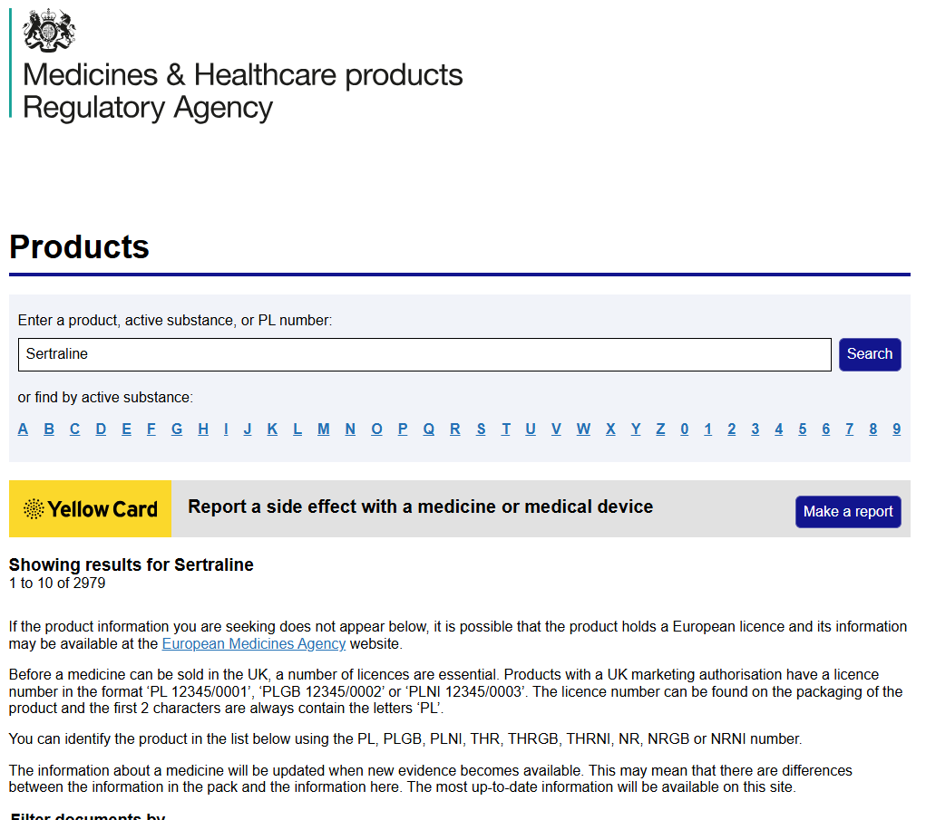
Website 1: - https://products.mhra.gov.uk/
Example product being searched for :- Sertraline 50mg/5ml oral suspension
1st time product (API name of the product “Sertraline”) search provides a disclaimer section asking the user to agree. (the screen is in next slide)

Slide 8
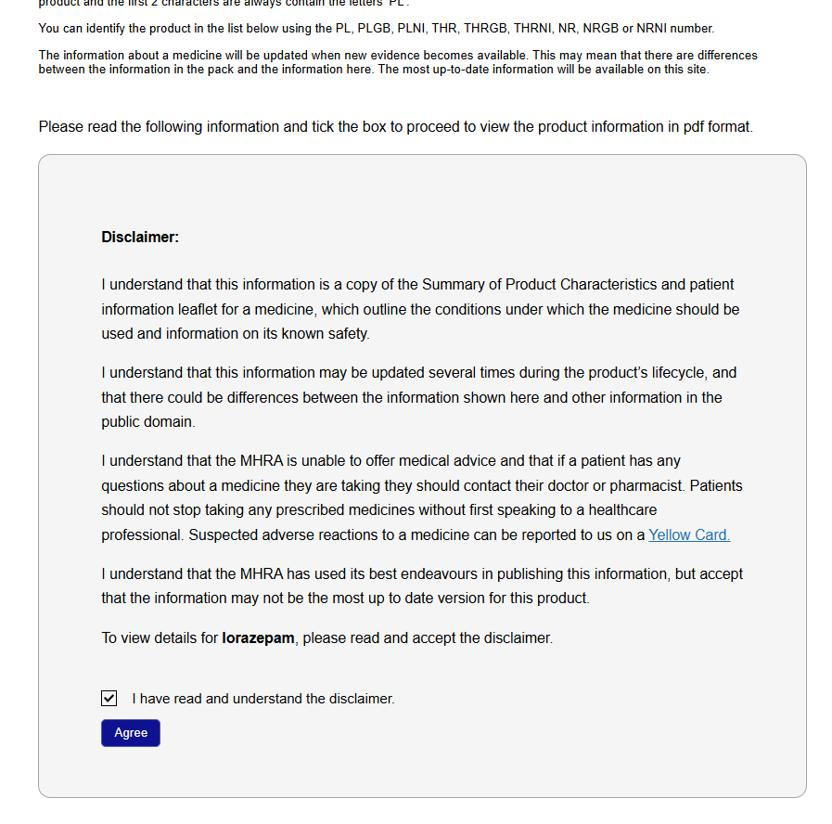
Website 1: - https://products.mhra.gov.uk/
Click on the check box and click on the Agree button.

Slide 9
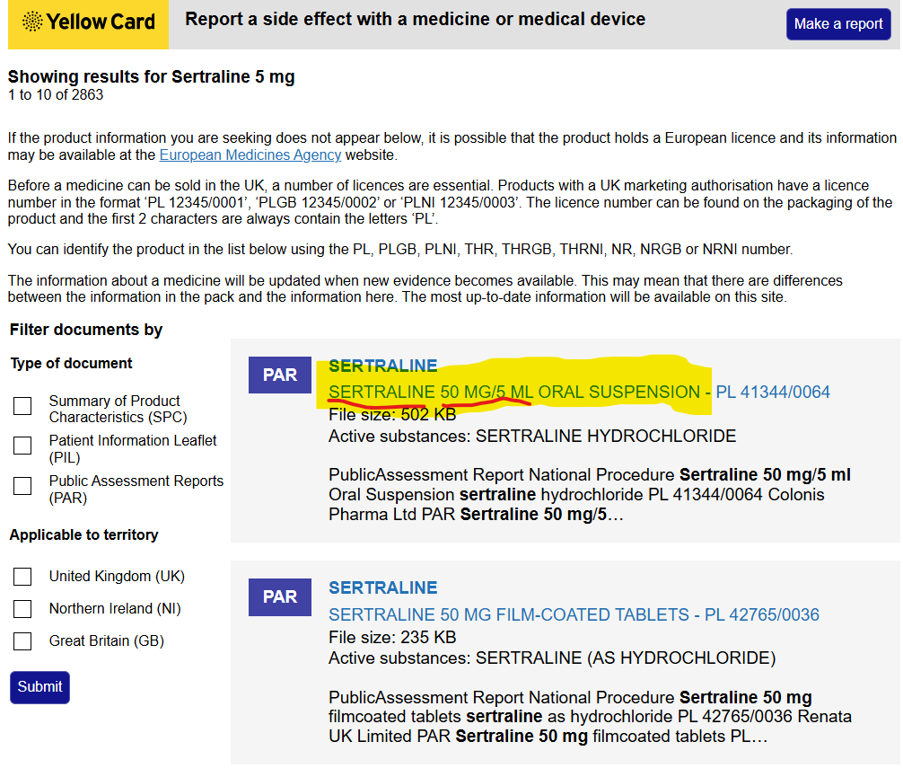
Website 1: - https://products.mhra.gov.uk/
The page provides the list of products starting with Sertraline.
The page has pagination, so we need to keep moving to the next page until the match is found.

Slide 10
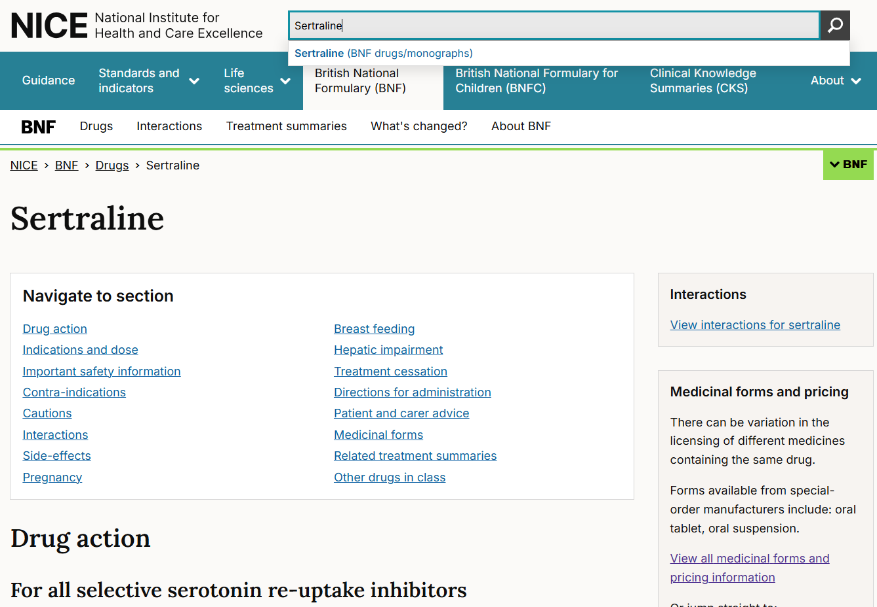
Website 2: - https://bnf.nice.org.uk/
Example product being searched for :- Sertraline 50mg/5ml oral suspension
Enter the API name of the product (Sertraline) and hit search. Don’t click on the drop-down value.

Slide 11
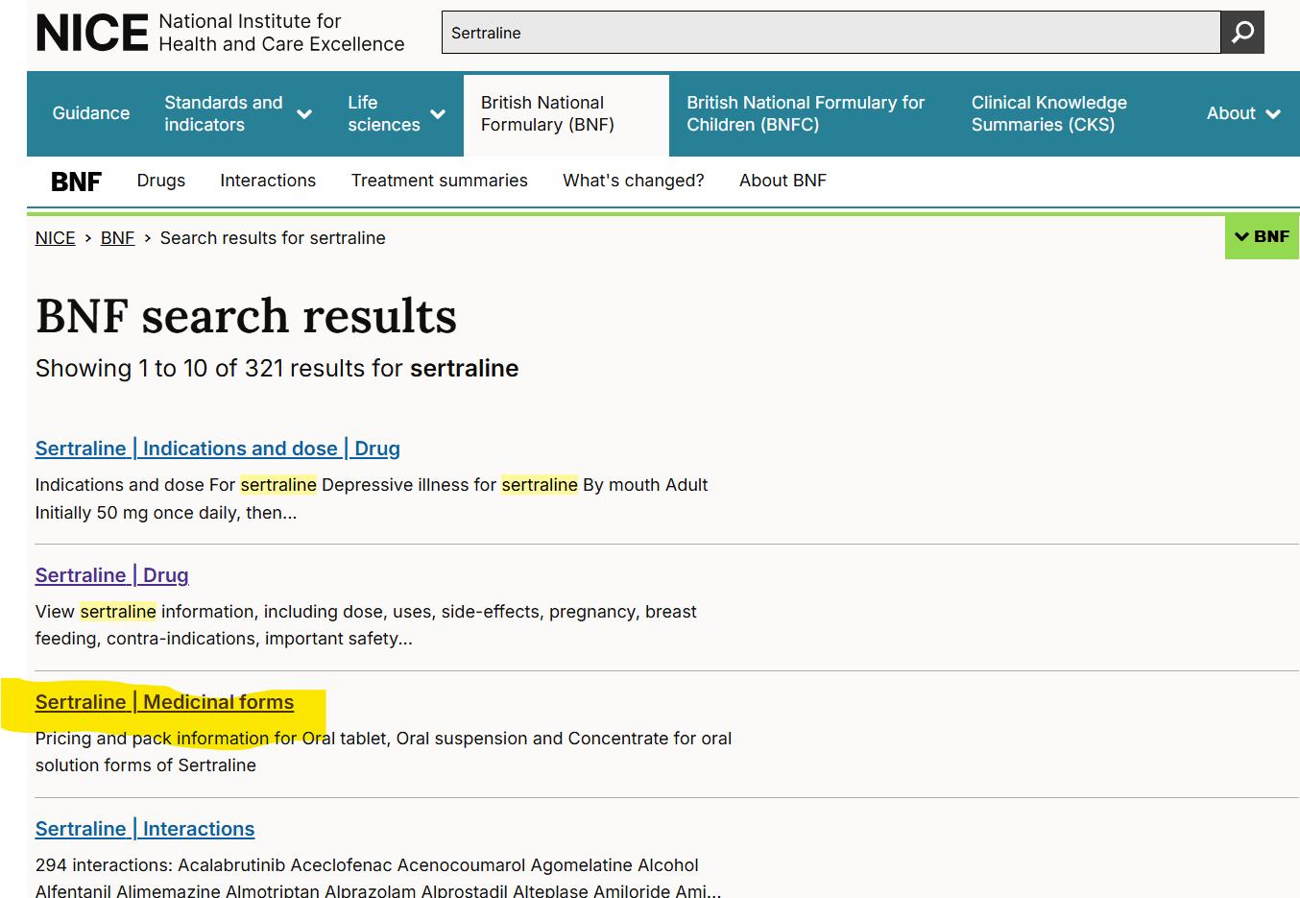
Website 2: - https://bnf.nice.org.uk/
Click on the “Medicinal forms”

Slide 12
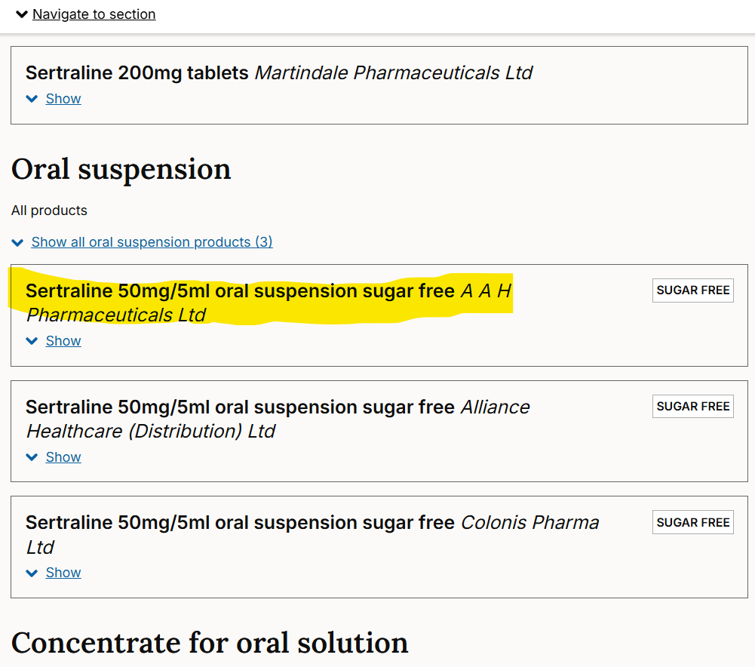
Website 2: - https://bnf.nice.org.uk/
The page provides the list of products starting with Sertraline.
The page doesn’t have pagination. We need to scroll down to search. We can also click on the “show” to double confirm.

Slide 13
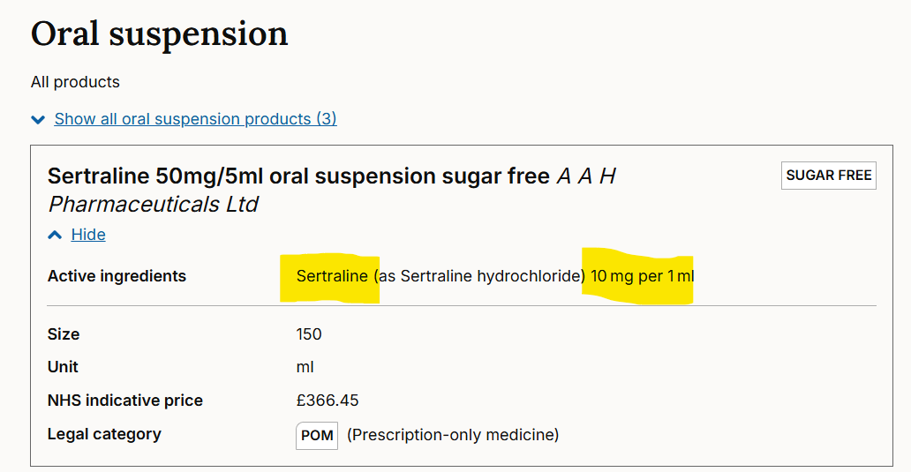
Website 2: - https://bnf.nice.org.uk/
In this case, the API name “Sertaline” matches and also 10 mg per 1 ml is equivalent to 50mg/5ml.
The logic is 50 / 5 = 10 / 1

Slide 14
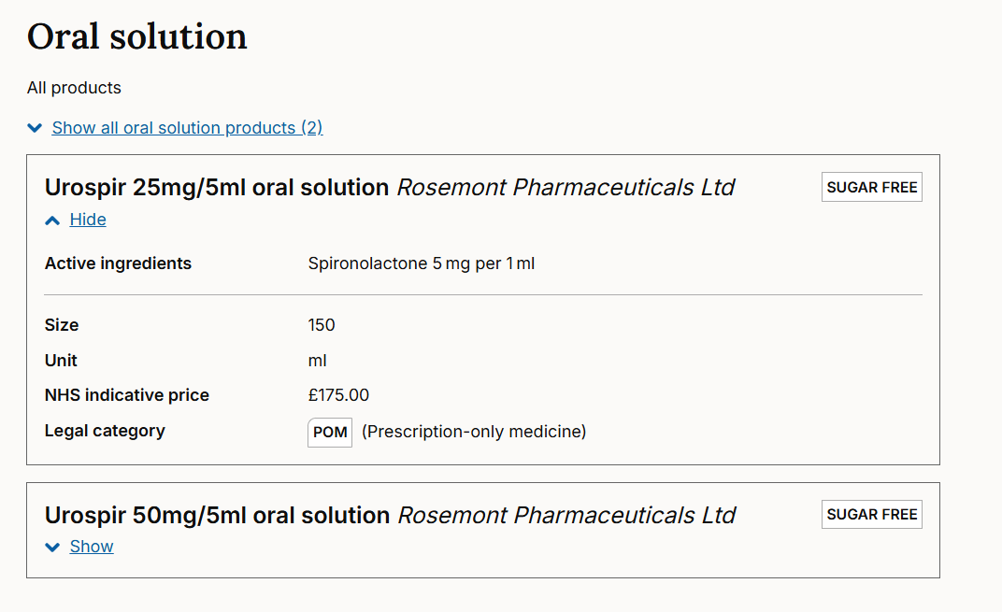
Website 2: - https://bnf.nice.org.uk/
Example 2
In the 2nd case above, the API name (Spironolactone) is not matching the main title product, however, matching with the keyword after clicking on the show button. However, the lead to this medicine is the strength.

Slide 15
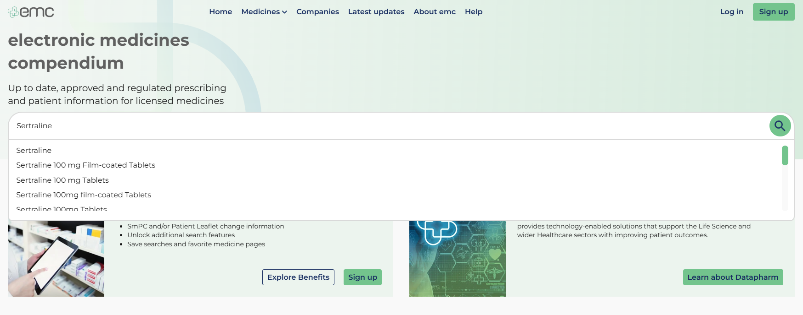
Website 3: - https://www.medicines.org.uk/emc
Example product being searched for :- Sertraline 50mg/5ml oral suspension
Enter the API name of the product (Sertraline) and hit search. No need to click on the drop-down value.

Slide 16
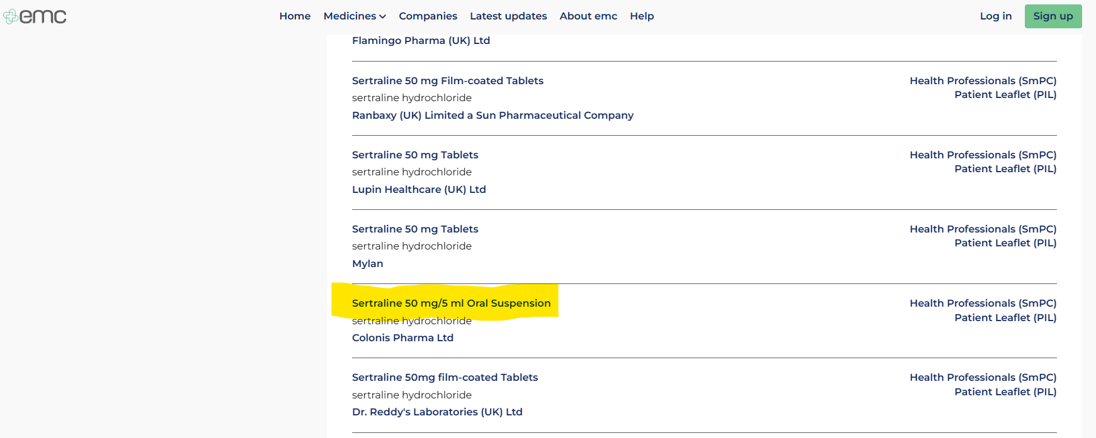
Website 3: - https://www.medicines.org.uk/emc
The page provides the list of products starting with Sertraline.
The page doesn’t have pagination. We need to scroll down to search.

Slide 17
Q & A

Slide 18
Questions & Clarifications
Exact Search Criteria:
Should the tool match all three components (API, Strength, Dosage Form) strictly, or are there scenarios where partial matches are acceptable (e.g., if only the dosage form differs)?
Are synonyms or alternative names for API and dosage forms allowed (e.g., "Suspension" vs. "Oral Suspension")?
Matching all 3 components is good. However, matching the API & Strength is mandatory because the forms may have synonyms. There are variations in the strength as well like 50mg/5ml could be 10mg/1ml (the example is there in previous slides). I have produced some example product search in the upcoming slides for your reference.
Error Handling:
How should the tool handle cases where one or more websites are unavailable or produce errors during scraping?
Should there be a retry mechanism or a placeholder message for unavailable data?
If sites are not reachable / broken, then mention “Site is down” message on our tool under the respective site column.
Search Result Storage:
What specific data needs to be saved in the database? For example:
Full product name.
Search results (Yes/No per website).
Date and time of search.
All the search results (which are ticked), inputs, including the full product name should be saved in the DB.
Is there a specific retention period for search data? This DB is for training the tool and to maintain the history. So, we can suggest the retention period and I can confirm with the users.
Feedback Mechanism:
How detailed should the feedback mechanism be? Should users only indicate if results are correct/incorrect, or should they also provide comments? Users will tick the product results marking the correct ones. If nothing is found they will have options to input the correct one they have searched. Please note that the some of the products may not have results which if OK for them to consider for their process.

Slide 19
Questions & Clarifications
Scalability:
Will there be a need to scale this tool for more websites or additional product parameters in the future? As of now the parameters and websites are same. No change for the near future.
Websites' Accessibility:
Are there any restrictions, CAPTCHA challenges, or authentication requirements on the target websites that could impact the scraper? No captcha or login needed.
Output Details:
If a product is found, should the result include detailed information (e.g., product description, link to the source page)? Capture the full product name. Link to source page is nice to have.
Should results be downloadable or printable? Download and printable – nice to have.
Compliance Requirements:
Are there specific data compliance or security measures (e.g., GDPR, encryption) to consider since the tool stores search data? No security measures. Users have been searching for this information.
User Authentication:
Is user authentication required to access the tool, or will it be open to all users? Open to all the users.
Localization:
Should the tool support multiple languages or regions in the future? Only English as of now. No change for the near future.
Examples for Testing:
Are there additional example products (besides "Lorazepam 1mg/5ml Suspension 100ml") for testing purposes? Please refer for examples in the next slides

Slide 20
Product examples

Slide 21
Product search examples
 | possible variation
Lincense product | MHRA website | BNF website | EMC website
Sertraline 50mg/5ml oral suspension | SERTRALINE 50 MG/5 ML ORAL SUSPENSION | Sertraline 50mg/5ml oral suspension sugar free | Sertraline 50 mg/5 ml Oral Suspension
Chloral hydrate 143.3mg/5ml oral solution | Chloral Hydrate 143.3mg in 5ml Oral Solution | Chloral hydrate 143.3mg/5ml oral solution (Chloral hydrate 28.66 mg per 1 ml )
Melatonin 5mg/5ml oral solution | SLEPLAG/MELATONIN 1 MG/ML ORAL SOLUTION | Melatonin 1mg/ml oral solution sugar free & Ceyesto 1mg/ml oral solution | Melatonin 1mg/ml Oral Solution
Lamotrigine 10mg/ml oral suspension | LAMOTRIGINE DESITIN 10 MG/ML ORAL SUSPENSION | Lamotrigine 10mg/ml oral suspension sugar free | Lamotrigine Desitin 10mg/ml Oral Suspension
Omeprazole 20mg/5ml oral suspension | OMEPRAZOLE 4MG/ML POWDER FOR ORAL SUSPENSION | Omeprazole 20mg/5ml oral suspension sugar free | Omeprazole 4 mg/ml, Powder for Oral Suspension
Spironolactone 25mg/5ml | SPIRONOLACTONE WAYMADE 25 MG/5 ML ORAL SOLUTION | Urospir 25mg/5ml oral solution Spironolactone 5 mg per 1 ml | Urospir 25 mg/5 ml Oral solution

Slide 22
Product search examples
Omeprazole 1mg/ml oral suspension | OMEPRAZOLE 1 MG/ML, POWDER FOR ORAL SUSPENSION | Omeprazole 1mg/ml oral suspension sugar free, Omeprazole 1 mg per 1 ml | Omeprazole 1 mg/ml Powder for Oral Suspension
Clonidine 50micrograms/5ml oral solution | CLONIDINE HYDROCHLORIDE 50MICROGRAMS/5ML ORAL SOLUTION | Clonidine 50micrograms/5ml oral solution sugar free,Clonidine hydrochloride 10 microgram per 1 ml | Clonidine Hydrochloride 50 micrograms/5 ml Oral Solution
Topiramate 50mg/5ml oral suspension | Topiramate Rosemont 10mg/ml and 20mg/ml Oral Suspension | Topiramate 50mg/5ml oral suspension sugar free | Topiramate Rosemont 10mg/ml Oral Suspension
Atorvastatin 20mg/5ml oral suspension | ATORVASTATIN 4 MG/ML ORAL SUSPENSION | Atorvastatin 20mg/5ml oral suspension sugar free | Atorvastatin 4mg/ml Oral Suspension
Azathioprine 50mg/5ml suspension | JAYEMPI 10 MG/ML ORAL SUSPENSION Active substances: AZATHIOPRINE | Jayempi 10mg/ml oral suspension Nova Laboratories Ltd,Azathioprine 10 mg per 1 ml | Jayempi 10mg/ml oral suspension
Lorazepam 1mg/ml oral solution | LORAZEPAM 1MG/ML ORAL SOLUTION , Lorazepam 1mg/ml Oral Solution | Lorazepam 1mg/ml oral solution sugar free | Lorazepam 1mg/ml Oral Solution
Haloperidol 5mg/5ml oral solution | 1mg/ml Oral Solution | Haloperidol 5mg/5ml oral solution sugar free | Haloperidol 1mg/ml Oral Solution
Haloperidol 200mcg/ml oral solution | Haloperidol 200micrograms/ml | Halkid 200micrograms/ml oral solution, Haloperidol 200 microgram per 1 ml | Halkid 200mcg/ml Oral Solution
Omeprazole 10mg/5ml oral suspension | Not to be found | Omeprazole 10mg/5ml oral suspension sugar free Rosemont | Omeprazole 2 mg/ml, Powder for Oral Suspension
Omeprazole 1mg/ml oral suspension | OMEPRAZOLE 1 MG/ML POWDER FOR ORAL SUSPENSION | Omeprazole 1mg/ml oral suspension sugar free | Omeprazole 1 mg/ml Powder for Oral Suspension

